Slide 1
WELCOME TO
THE PRESENTATION
Presented by:-
Islam, md.nur (18-36856-1)
Marjana Akhter jenia(18-36907-1)
Farjana khatun(18-36875-1)
Java SEC : N

Slide 2


E - pharmacy
Course teacher:
MD. SIYAMUL ISLAM
Faculty of Computer Science dept.
American International University, Bangladesh

Slide 3
introduction
Now a days almost everyone in our city uses smartphones. Now-a-days online Market has become a very big place. Specially in Dhaka city almost everyone who uses internet there is a strong possibility that he/she might buy something from online. Everything is now available online. As we know Medicine is one of the most common need in our city life now-a-days. So we will sell medicine to the customer via this software.
We are going to launch a easy approach for best solution to the pharmacy sector.

Slide 4
Users category
There are two types of Users here. They are:
  User/Buyer
    User will register to the account for their desire Medicine.
  Admin
    Admin will monitor and supply the medicines to the customer via local supplier.

Slide 5
Features of User/Buyer
Register For new account
Login
Search Medicine
Add Medicine to Cart
Remove Medicine from Cart
Request For new Medicine
View Purchasing history
Buy Medicine from the cart
Logout

Slide 6
Features of admin
Login
Add new Medicine
Add quantity to existing Medicine
Remove Medicine
Accept Orders
Add requested Medicine
Logout

Slide 7
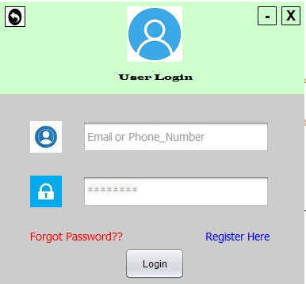
Some gui

Slide 8
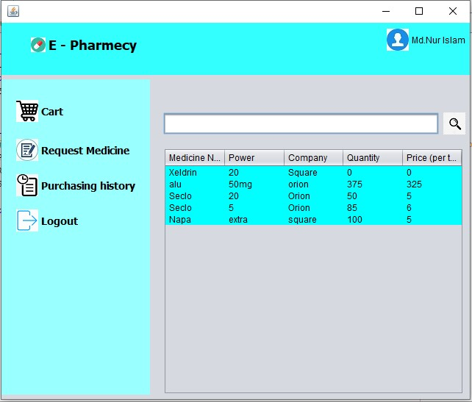

Slide 9
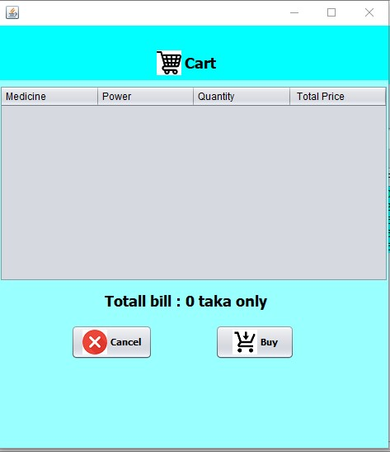

Slide 10
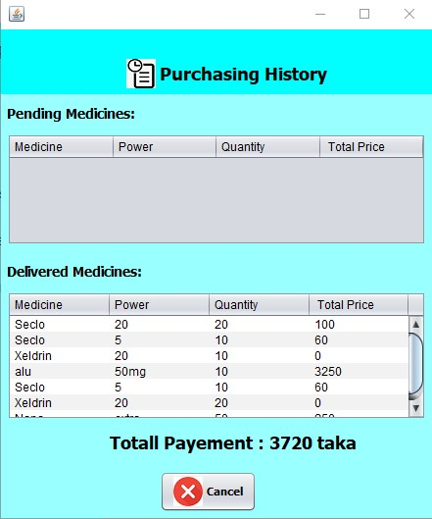

Slide 11
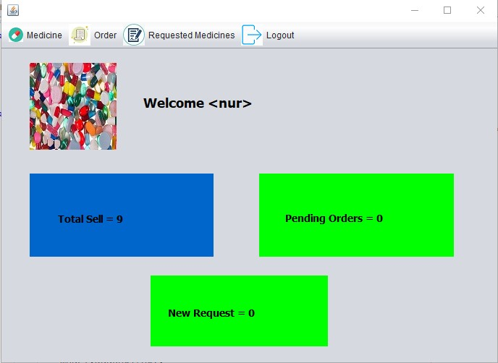

Slide 12
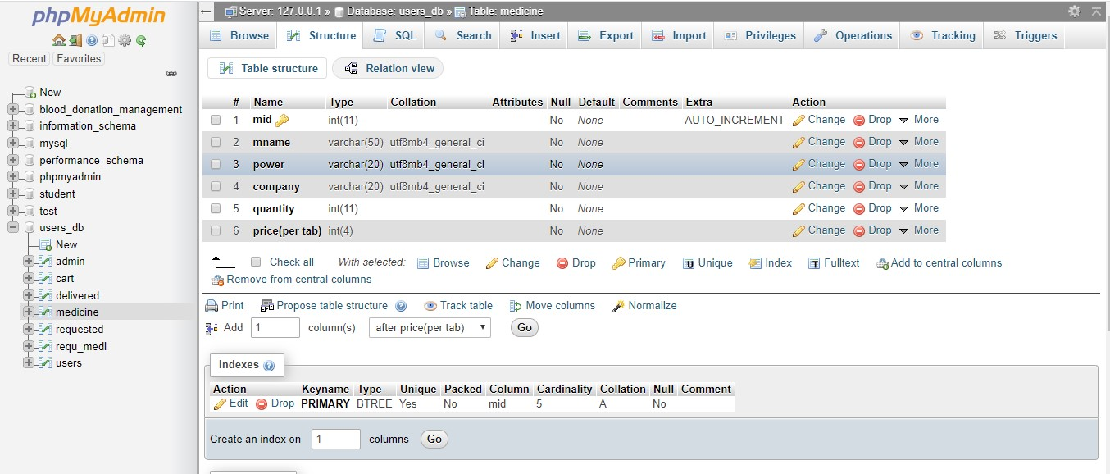
Database Table Description:

Slide 13
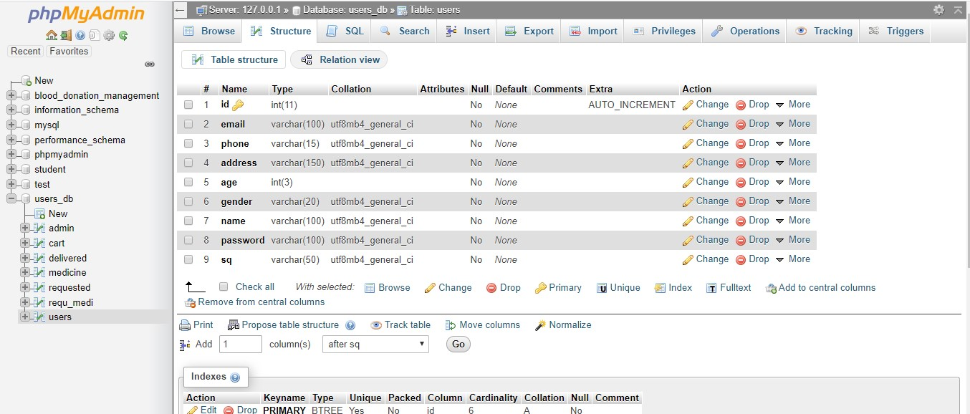

Slide 14
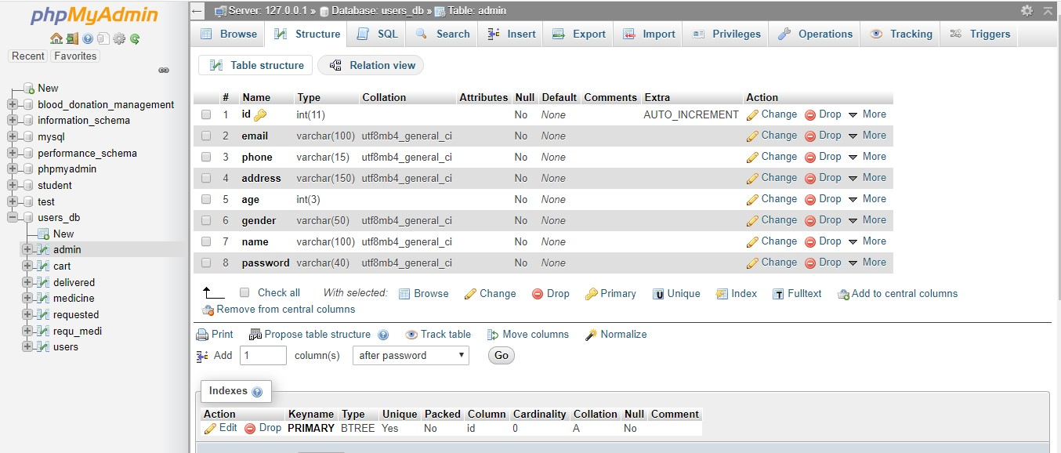

Slide 15
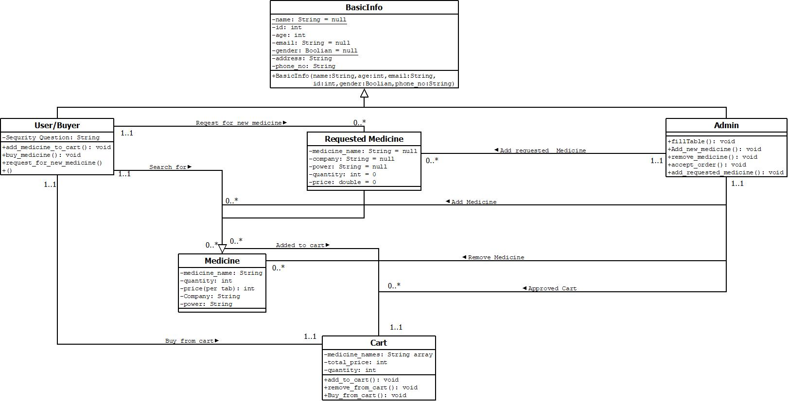
Class Diagram

Slide 16
Impact on society
In Dhaka city Medicine is become one of our daily need. There are so many people who has to take medicine everyday and there are some occasional user also. So its become a important need for us. There are so many pharmacy here and there and everyday they are selling a huge amount of medicines. Sometimes some pharmacy may take extra charge for the medicine from the consumer. And sometime there are no time or no one to go the pharmacy to buy medicine for you. So our software will reduce the chance of extra charge and deliver medicine to everyone’s doorstep.

Slide 17
How people will be benefited
They can buy Medicine with no extra Charge.
Fastest Home Delivery.
Cash on Delivery Service.
Always will get the right medicine.

Slide 18
Limitations:
For the Time being we are limited to some important places of Dhaka.
Due to man power delivery is a little slow.
Software is not so User Friendly till now.
All the medicine is not available.
Possible Future Improvements:
We will sell Medicine to every Corner of the country.
Deliver will be faster in near future soon.
More Feature will be added to the software.
Software will be more user Friendly.
More Medicine will be added soon.

Slide 19


